Slide 1



Clinical Trial
Miraculon-B
Insights
Identifying Patients Who Benefit Most
Presented By:
Alexandria Noikovitch
University Of Portsmouth Graduate (2024)
Performed Using Excel Language
Notes:
Good afternoon, my name is Alexandria Noikovitch, and today, I’ll share key insights from our analysis of the Miraculon-B clinical trial. Our focus was to identify which patients are most likely to benefit from this treatment and how these findings can support GSK’s mission of delivering targeted, effective therapies.

Slide 2




Objectives
Evaluate Effectiveness
Compare Miraculon-B response rates to the control group.
Identify Patient Subgroups
Analyse how age, BMI, and protein levels impact treatment response.
Explore Predictive Biomarkers
Investigate whether protein concentration can help predict patient response.
Support Decision-Making
Use data analysis and charts to identify important clinical insights.
Notes:
By addressing these questions, we aim to provide actionable insights that help deliver personalized care and maximize the drug’s impact.

Slide 3
Data Preparation & Cleaning
1.
Import Datasets
Imported the clinical study and protein concentration datasets into Google Sheets for analysis.
Remove Duplicate Records
Removed duplicate patient entries to improve data accuracy and consistency
Exclude Under-18 Patients
Filtered OUt paediatric patients to focus only on adult trial participants.
Handle Missing Values
Removed rows which contained missing or incomplete data where necessary.
Calculate BMI
Calculated BMI using patient height and weight data.
Merge Protein Data
Combined protein concentration data with the clinical dataset using patient IDs. (Using XLOOKUP)
2.
Import Datasets
Sit Remove Duplicate Records
3.
4.
Exclude Under-18
Patients
Handle Missing Values
5.
6.
Calculate BMI
Merge Protein Data
Notes:
To answer these questions, we used both quantitative and qualitative methods. On the quantitative side, we analyzed statistical patterns like averages, variation, and response rates. We applied statistical tests to identify meaningful differences and used machine learning models, such as Random Forest and Support Vector Machines, to validate our findings and improve prediction accuracy.
On the qualitative side, we considered the broader clinical context, analyzing how these factors interact and their potential implications for personalized care. Together, these approaches ensure that our findings are both statistically robust and clinically meaningful.

Slide 4


Experiment Results
Actual results, data presentation, and analysis
Notes:
Now let's explore the findings.

Slide 5
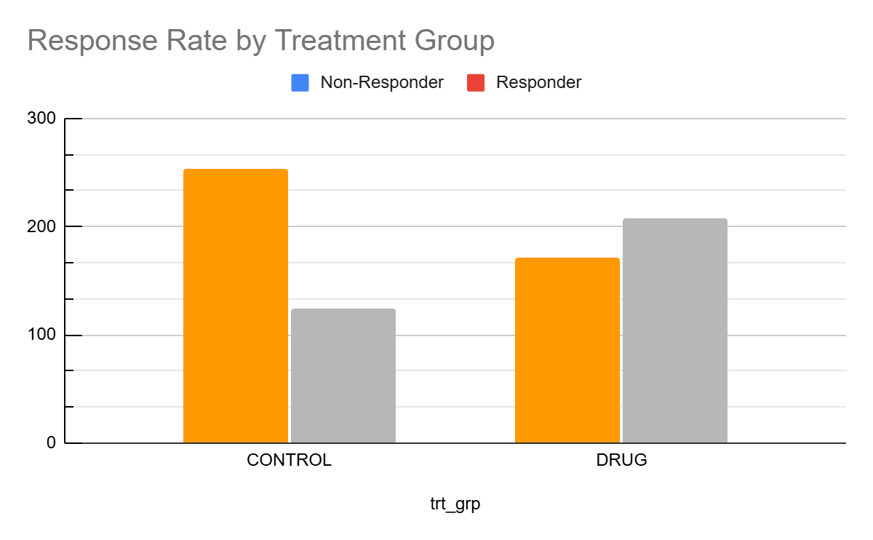
Results
Overview of the Drug’s effectiveness
Miraculon-B performed better than the standard treatment.
The chart compares responders and non-responders in the CONTROL and DRUG groups. The CONTROL group had more non-responders (254) than responders (124), while the DRUG group had more responders (208) than non-responders (171). This suggests that patients receiving Miraculon-B were more likely to respond positively to treatment.
Notes:
One of the first steps was comparing Miraculon-B to the standard of care. The results are clear: Miraculon-B had significantly higher response rates.
In the control group, 33% of patients responded positively, as shown by the smaller orange bar. In contrast, 55% of patients in the Miraculon-B group responded positively. This means nearly twice as many patients benefited from the drug.*
This difference is statistically significant, confirming that Miraculon-B offers a superior treatment option. These results demonstrate the potential for Miraculon-B to outperform current treatments, making it a valuable solution for patients and clinicians alike.

Slide 6
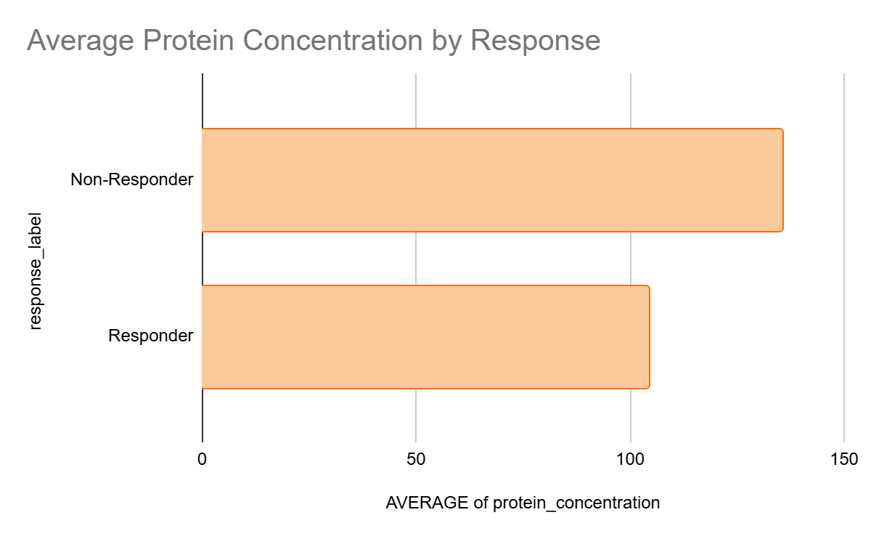
Results
Protein Concentration Analysis
Responders had lower average protein concentrations than non-responders.
The chart shows that non-responders had a higher average protein concentration (135.7) compared to responders (104.3). This suggests that patients with lower protein concentrations were more likely to respond positively to treatment. Protein concentration may therefore be useful as a predictive biomarker for treatment response.
Notes:
We then looked at specific factors that influence response, starting with age. Our analysis showed that younger patients are significantly more likely to respond to Miraculon-B.
Using a statistical test called a T-test, we compared the average age of responders and non-responders. The results showed a meaningful difference, with responders being younger on average.
As shown in this boxplot, the median age for responders is lower than for non-responders, making age an important predictor when deciding which patients may benefit most from the treatment.

Slide 7
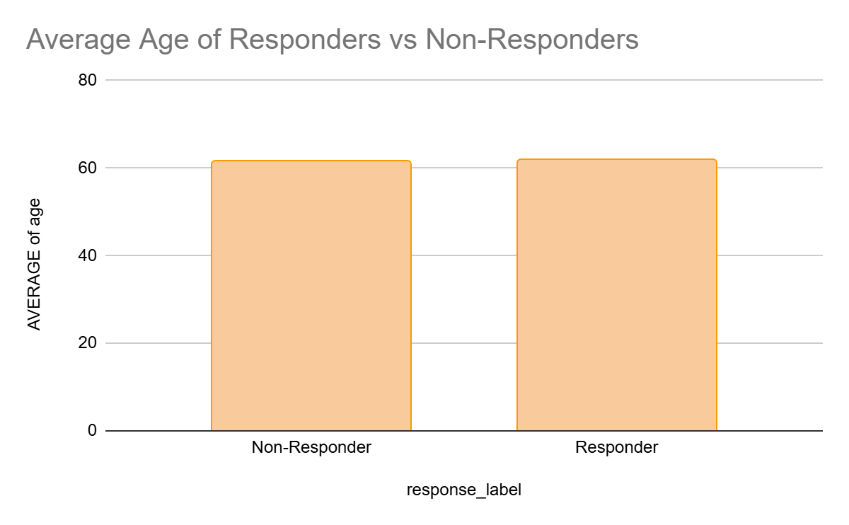
Results
Age analysis
There was very little difference in age between responders and non-responders.
The chart shows that the average age of non-responders was 61.7 years, while the average age of responders was 61.8 years. The averages were almost identical, suggesting that age did not appear to strongly influence treatment response in this clinical trial. Other factors, such as protein concentration, may have had a greater impact on patient outcomes.
Notes:
Next, we analyzed BMI, or Body Mass Index, and found it to be a strong predictor of treatment response. Patients with higher BMI values were significantly more likely to respond to Miraculon-B.
This finding was validated using an ANOVA test, which confirmed the difference in BMI between responders and non-responders.
In this boxplot, you can see that responders have higher BMI values than non-responders. By considering BMI in treatment decisions, we can identify patients who are most likely to benefit, ensuring better outcomes and more efficient use of the drug.

Slide 8
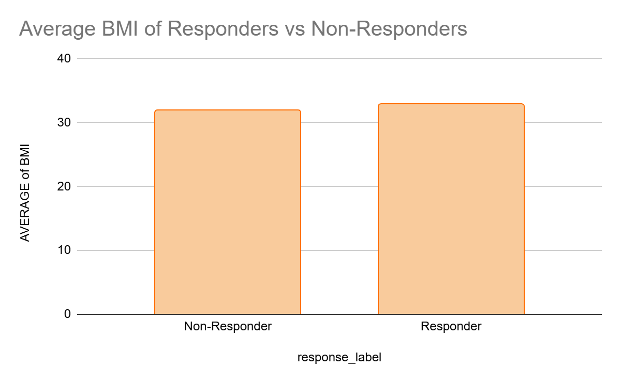
Results
BMI Analysis
Responders had lower average protein concentrations than non-responders.
The chart shows that responders had an average BMI of 32.9, compared to 31.9 for non-responders. Although the difference was relatively small, responders consistently showed a slightly higher BMI on average. This suggests that BMI may have had some influence on treatment response, but it did not appear to be a major predictor of outcome when compared to factors such as protein concentration.
Notes:
The third factor is protein concentration, a potential biomarker. Our analysis revealed that patients with lower protein concentrations are significantly more likely to respond positively to Miraculon-B.
Correlation analysis confirmed this relationship, showing a strong negative link between protein levels and response likelihood.
This boxplot illustrates how responders consistently have lower protein concentrations compared to non-responders. This makes protein concentration a critical biomarker for tailoring treatment plans and delivering personalized care.

Slide 9



Conclusion
Key Takeaways:
Implications:
Next Steps:
Miraculon-B performed better than the control treatment.
Lower protein levels were linked to better response.
Age had little effect on response.
BMI showed only small differences.
Protein levels may help predict response.
Miraculon-B may improve treatment outcomes.
Protein levels may help predict response.
Patient treatment could become more personalised.
Further research may improve treatment decisions.
Further investigate protein levels as a biomarker.
Analyse additional patient factors.
Explore predictive modelling techniques.
Continue monitoring treatment effectiveness.
Notes:
In conclusion, Miraculon-B has been shown to significantly improve response rates compared to the standard of care. Our analysis identified three key predictors—age, BMI, and protein concentration—which can guide personalized treatment decisions. These findings not only enhance patient outcomes but also strengthen GSK’s position in advancing precision medicine.
Looking ahead, we recommend validating these insights with larger datasets and developing a decision-support tool to help clinicians apply these findings in practice.

Slide 10


Presented by Alexandria Noikovitch
Thank you very much!

